Slide 1
ClimbCode
Notes:
Welcome to ClimbCode’s exposition. Here we’ll see the results of the development’s third sprint of this project.

Slide 2

Our Path Today
Idea
Technologies & Work
Things Done
Pilot Plan’s Results
Status
2
Notes:
This is the path we’re going to follow during the presentation. First we’ll introduce the idea behind ClimbCode, next we’ll see the technologies we’re using to develop ClimbCode, after that, we’ll talk about the things we’ve done, the results of our pilot plan and the current status of the project.

Slide 3
Idea
Notes:
We’ll start seeing which idea lies behind ClimbCode. But first, let’s travel a bit back in time:

Slide 4

4
Notes:
We’re sure everyone remembers those days at high school in which they had a lot of homework to do, copying the questions and doing them to show them in class. A bit boring and tiring, wasn’t it? And also for the teacher, because he/she also needed to search in the books the exercises he/she wanted us to do.

Slide 5

5
Notes:
Then… What if there was back in those days a way to do both things easier and faster? A way to do those tasks in our computers?

Slide 6


Idea
+
=
ClimbCode
6
Notes:
The answer to this is ClimbCode, our web platform, which acts as a supporting tool for teaching subjects at schools with the help of software.

Slide 7


Idea
Interactive
7
Notes:
How do we grant this support? Simple, by interactive exercises, a better version of the original paper exercises made by independent programmers. Those exercises are bought by schools in order to increase their content catalog they have for supporting their subjects.

Slide 8
Technologies & Work
Notes:
Now we’ll talk about the technologies we’re using to develop ClimbCode, and the work methodology we’re following.

Slide 9

Work Methodology
SCRUM
9
Notes:
In order to develop our project, we’ve chosen SCRUM as our work methodology with variations, like having weekly metings instead of daily ones, but always having in mind typical concepts such as the product backlog and the sprint backlog.

Slide 10




Technologies
Main:
10
Notes:
For the main development of our project, we’re using PostgreSQL, Django and Python for our back-end, and Bootstrap for our front-end.

Slide 11

Technologies
Deployment:
11
Notes:
For the deployment of the project, we’ve used Digital Ocean.

Slide 12




Technologies
Interactive Exercises:
12
Notes:
For the interactive exercises’ system, we’re using JavaScript, with Ace for a little help with the syntax, Chart.js for creating the graphics and pictures for the exercises and AJAX.

Slide 13

Technologies
Knowledge:
13
Notes:
Finally, for our knowledge management we’re using a git repository hosted in GitHub.

Slide 14
Things Done
Notes:
Now we’ll see the things we’ve already done in our project.

Slide 15



Problems’ Status
PROBLEM | SOLUTION | METRIC | RESULT
 |  | TOTAL PROBLEMS (> 0) | Before: 3 After: 3
 | SP & PRIORITIES | ESTIMATION ERROR (< 10%) | Before: 15% After: 13%
15
Notes:
First, we’ve been analysing our problems and the solutions given to them, resulting in this table we see here. The table shows our principal problems: The first is the fact that we found difficult to document the problems we previously found. To solve it we decided to create a document in which we could put all the problems we could find during the development process. As we see, measuring the problems documented per week we can see that the problem has been completely solved, because the number of problems documented has increased, staying above the ratio of 0 we considered as the minimum acceptable level for this metric.
The second problem is that we found hard to estimate our tasks, so we decided to put Story Points on our requirements and relate them to our tasks, measuring the error between the estimations and the real time invested in those tasks. In addition, to increase the efficiency of the tasks’ distribution, we’ve also put a priority for each task in this sprint, allowing them to be distributed better and lowering our metric. The result of this is that the deviation has decreased, but still we need to keep improving this system in order to keep those figures the maximum amount of time that we can.

Slide 16


Problems’ Status
PROBLEM | SOLUTION | METRIC | RESULT
 |  | BIG TASKS (< 10%) | Before: 17% After: 13%
16
Notes:
Finally, the other problem we’ve tried to solve was that there were many big and indivisible tasks, so we decided to find ways to divide them and make them lighter and smaller. To measure the success of this solution we used the percentage of big tasks (more than 3 estimated hours) we have in our project, showing that the solution is working at the moment and the problem seems solved, but still needs to decrease to a 10%, which is the accepted limit for it.

Slide 17
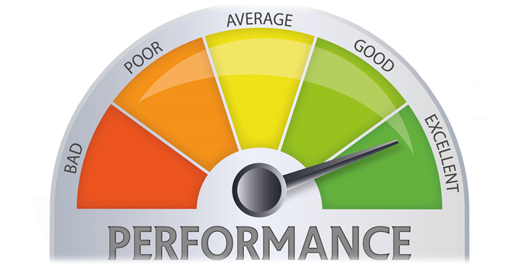
Performance
COMPLETED SP / REAL TOTAL HOURS
17
Notes:
We’ve also updated our metric to measure the performance of our team members in matters of tasks. The new version of the metric uses the current completed story points done by the member in the sprint, and the total amount of hours spent by that member for doing those story points, resulting in a percentage which shows the performance of the team member based on his tasks completed during the week and the hours spent on them.

Slide 18
Contingency Plan
Punishments
+
Team Building
+
Tasks’ Distribution
18
Notes:
During this sprint, we’ve also developed a contingency plan in case that problems inside our team appear. That plan is based in “punishments” done during our team building sessions, helping our rewards system, too. Also, in case of problem, the tasks of the sprint would be redistributed if a member can’t do his work, having also an emergency meeting in case that the problem gets too dangerous.

Slide 19


Features
Transactions
Interactive
Ordinary Use Cases
19
Notes:
In terms of features, we’ve finished all the ones we had as our MVP: Our interactive exercises’ system, allowing it to create and save them on our platform, our transactions’ system, allowing to buy and sell interactive exercises and letting programmers get their money from the purchases of the exercises, and many other minor use cases of our Django model.

Slide 20


Features
Security
Style
Feedback
20
Notes:
Those features include solving security problems, the preparation and correction of the style of our platform, and the implementation of all the feedback we’ve got during our pilot plan and that we could include in our project.

Slide 21

Everyone’s Tasks
EVERYONE
11h 30min
21
Notes:
Talking now about the concrete tasks done by the team, everyone in the sprint has participated in meetings whose objective was to review the presentations of the sprint and see how the project was developing. That resulted in a total of 11 hours and 30 minutes per member.

Slide 22
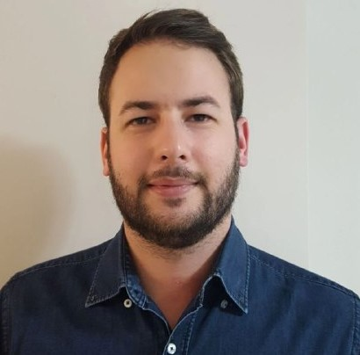


Personal Tasks
Alejandro Román, Project Manager
ESTIMATED
REAL
 | 2 h | 1h 29min
 | 2h | 2h
 | 2h | 1h 14min
22
Notes:
Now speaking member by member, Alejandro Román, our project manager, has been working this sprint helping with the second presentation of the sprint, the automation of the login system and with the analysis of our pilot plan’s results…

Slide 23

Personal Tasks
Alejandro Román, Project Manager
ESTIMATED
REAL
 | 22h | 17h 49min
TASKS | 2h | 2h 15min
PROGRESS: 100% PERFORMANCE: 103%
23
Notes:
…Doing the tasks’ distribution and he’s also been working in the notebook’s read-only view, solving the problems left by last sprint and correcting its bugs. He has completed the 100% of his tasks, with a performance of 103% during the sprint.

Slide 24


Personal Tasks
Álvaro Domínguez, Business Manager
ESTIMATED
REAL
 | 10 h | 7h 57min
 | 2h | 25 min
 | 8h | 5h 55 min
24
Notes:
Álvaro Domínguez, our business manager, has been working this sprint creating the two presentations done in it, their respective upgrade reports, the application of the pilot plan…

Slide 25
Personal Tasks
Álvaro Domínguez, Business Manager
ESTIMATED
REAL
WELCOME PAGE | 1 h | 47 min
CONTINGENCY PLAN | 1h | 23 min
PROGRESS: 100% PERFORMANCE: 106%
25
Notes:
The upgrade of our welcome page and the creation of the contingency plan. That resulted in a 100% of the progress of the task and a performance of 106% during the sprint.

Slide 26
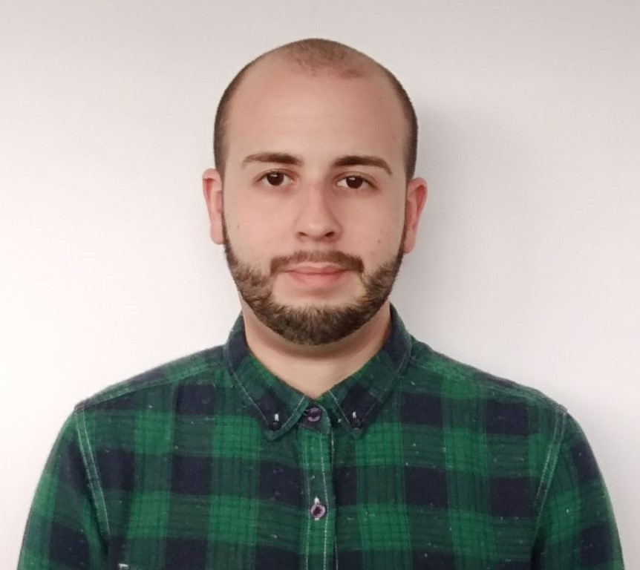

Personal Tasks
Miguel Ángel Baños, Front-End Developer
ESTIMATED
REAL
 | 20h | 21h 37min
 | 8h | 10h
PROGRESS: 100% PERFORMANCE: 101%
26
Notes:
Now talking about our front-end developers, Miguel Ángel Baños has been working solving security issues related to our interactive exercises’ system, in its read-only view and solving other bugs and probelms in that system. He has completed his tasks in a 100%, with a performance of 101% this sprint.

Slide 27
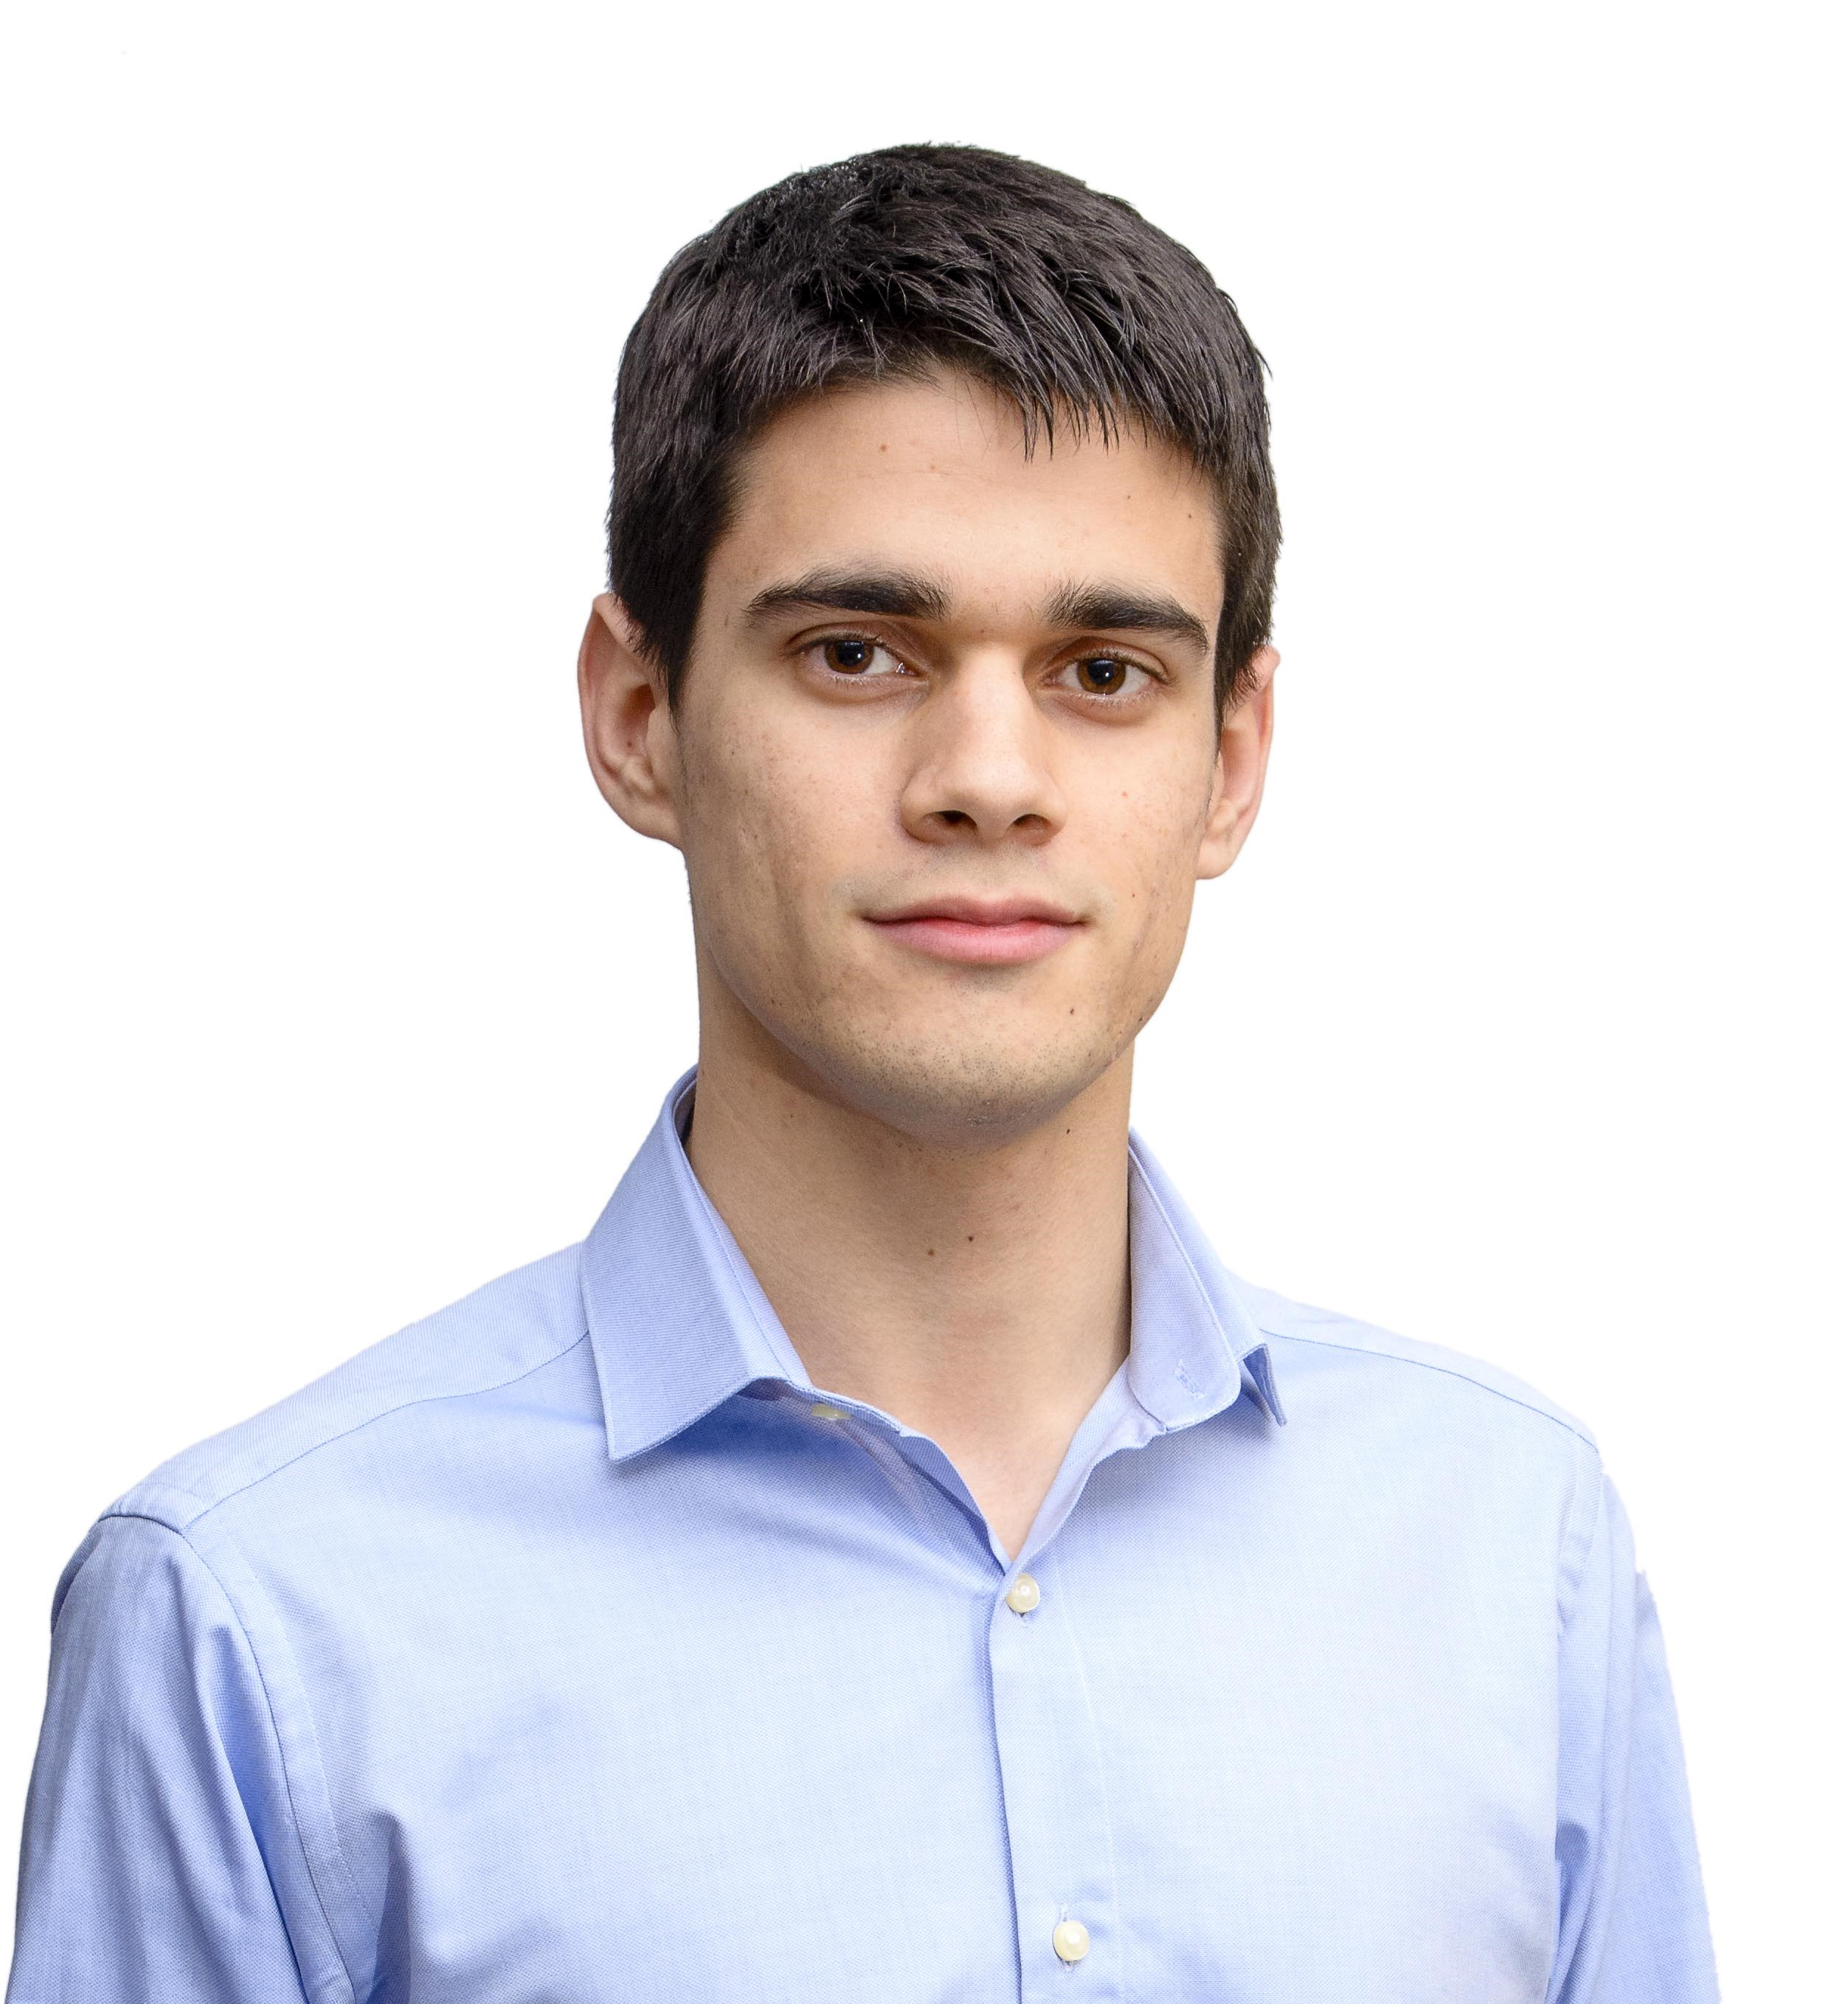
Personal Tasks
Alejandro Garrido, Front-End Developer
ESTIMATED
REAL
 | 21 h | 21h
METRICS | 1h | 30min
27
Notes:
Alejandro Garrido has been working in the upgrade of our platform’s style and navigability, in the management and update of our metrics…

Slide 28
Personal Tasks
Alejandro Garrido, Front-End Developer
ESTIMATED
REAL
BUDGET | 1 h | 1h
PROGRESS: 100% PERFORMANCE: 102%
28
Notes:
… And in the update of our budget, sorting it by each kind of spending. He has completed his tasks in a 100%, with a performance of 102% this sprint.

Slide 29
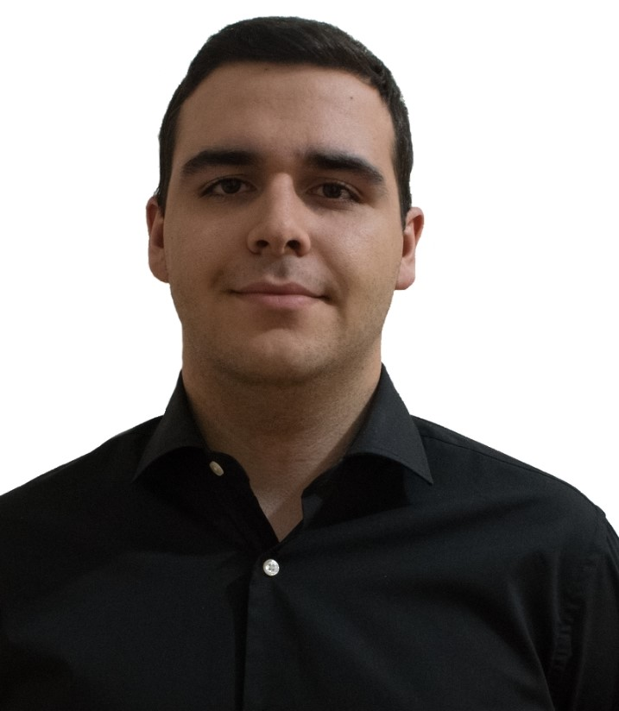
Personal Tasks
Andrés Ferández, Back-End Developer
ESTIMATED
REAL
 | 3 h | 2h 50min
 | 11h | 10h 55min
29
Notes:
Finally, about our back-end developers, Andrés Fernández has been working in solving bugs in our Django model, solving issues related to our platform’s security…

Slide 30

Personal Tasks
Andrés Ferández, Back-End Developer
ESTIMATED
REAL
 | 9 h | 10h 45min
PROGRESS: 100% PERFORMANCE: 94%
30
Notes:
… And in the possibility of registering teachers and students in our platform automatically using a .csv file. He has completed a 100% of his tasks, with a performance of 94% this sprint.

Slide 31
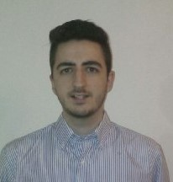

Personal Tasks
Jesús Sosa, Back-End Developer
ESTIMATED
REAL
 | 5h | 6h
 | 16h | 21h
 | 4h | 4h 30min
31
Notes:
Jesús Sosa has been working in the creation of our demos during this sprint, the solution of bugs in our Django model, the solution of security issues…

Slide 32
Personal Tasks
Jesús Sosa, Back-End Developer
ESTIMATED
REAL
INTERACTIVE EXERCISES | 3 h | 2h 32min
PROGRESS: 100% PERFORMANCE: 82%
32
Notes:
… And finishing our interactive exercises’ starting set. He’s had a performance of 82% this sprint, finishing a 100% of his tasks.

Slide 33
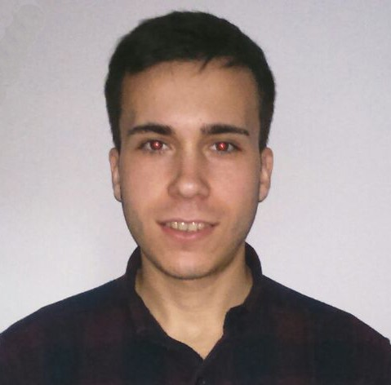
Personal Tasks
Álvaro Sánchez, Back-End Developer
ESTIMATED
REAL
 | 18h | 15h
 | 6h | 8h
33
Notes:
Finally, Álvaro Sánchez has been working in our transactions’ system, solving bugs in our Django model…

Slide 34
Personal Tasks
Álvaro Sánchez, Back-End Developer
ESTIMATED
REAL
 | 1h | 1h
PROGRESS: 100% PERFORMANCE: 104%
34
Notes:
… And helping with the analysis of our pilot plan’s results. He’s finished a 100% of his tasks, having a performance of 104% during this sprint.

Slide 35
Group’s Hour Deviation
35
Notes:
To see better the big picture behind the hours’ invested by each member, we have this graphic in which we can see the difference between the estimated hours and the real hours invested by each member during this sprint. As we see, the difference has decreased since last time, but still there is work to do if we want to keep these figures and get better ones in our peaks.

Slide 36
Deployment & Demo
Deployment URL: www.climbcode.tk
Demo URL:
https://www.youtube.com/watch?v=_pAyQNXK4IY
36
Notes:
To show how the system works today, we’ve put a link in which everyone can see our project, and also we’ve created a demo, showing our star use case: The creation and buying of an interactive exercise.
Demo: https://www.youtube.com/watch?v=_pAyQNXK4IY
Paypal’s credentials for a school: schoolCC@hotmail.com / climbcodeISPP2018
Admin Account: administrador / climbcode

Slide 37
Pilot Plan’s Results
Notes:
Now we’ll see the results of applying our pilot plan.

Slide 38


Pilot Plan
38
Notes:
We designed a pilot plan based in meetings with programmers and teachers, showing them our platform, how an interactive exercise is and works, and asking them what did they think about our star use case (creation and purchase of interactive exercises), what suggestions did they have for our project, what did they think we could change, and how much would they pay for each thing of our platform (licenses and exercises).

Slide 39


Results: Feedback
39
Notes:
From the feedback we received, we decided to include the automatic registration of teachers and students with a .csv file to save time to schools and to keep safe the student’s personal information.
Also, our school users didn’t seem interested in programming in our platform or learning to do it, so we decided to focus in our interactive exercises.

Slide 40


Results: Feedback
DASHBOARD
40
Notes:
On the other hand, we discarded to include other different ideas because they didn’t fit our business idea, such is the case of changing interactive exercises to pdf in order to print them, correcting those exercises automatically or including a dashboard in which we can browse our teachers and students’ activity in our platform.

Slide 41
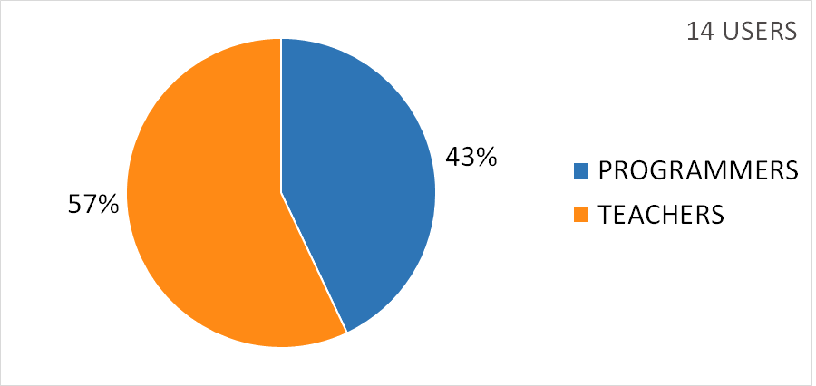
Results: Figures
41
Notes:
As a result of our pilot plan, we’ve got an amount of 14 users for our platform, from the 26 inverviewed, divided bewteen teachers and programmers as we see in the graphic. We’ve also received messages from other users asking to join the platform, so we expect to see an increasing in these numbers as time goes on.

Slide 42
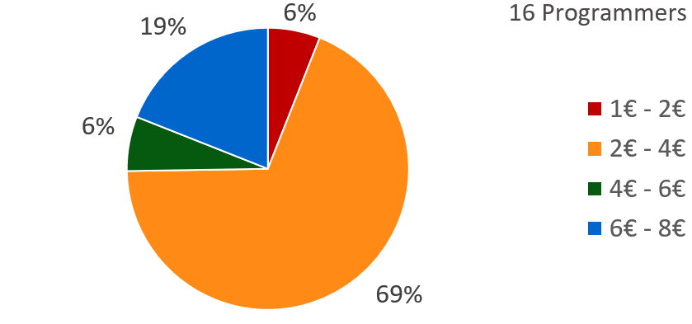
Results: Figures
Exercises’ price (Programmers)
42
Notes:
From all the programmers we’ve interviewed, the 69% finds reasonable a price between 2 and 4 euros for each purchase of an exercise.

Slide 43
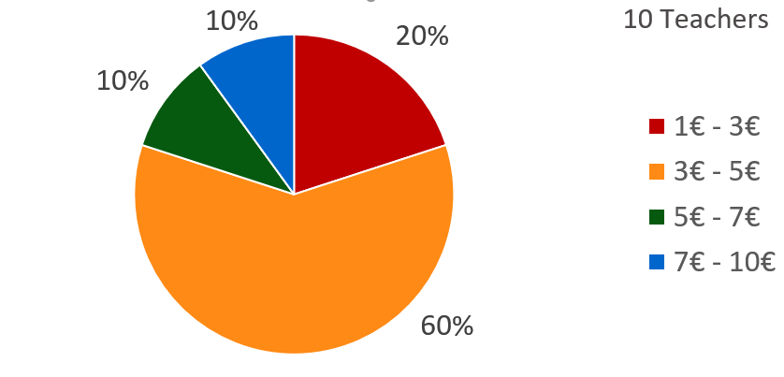
Results: Figures
Exercises’ price (Teachers)
43
Notes:
Also, we’ve asked the schools for those prices, showing that they mostly agree with the programmers, choosing a price which is between 3 and 5 euros per purchase of an exercise.

Slide 44
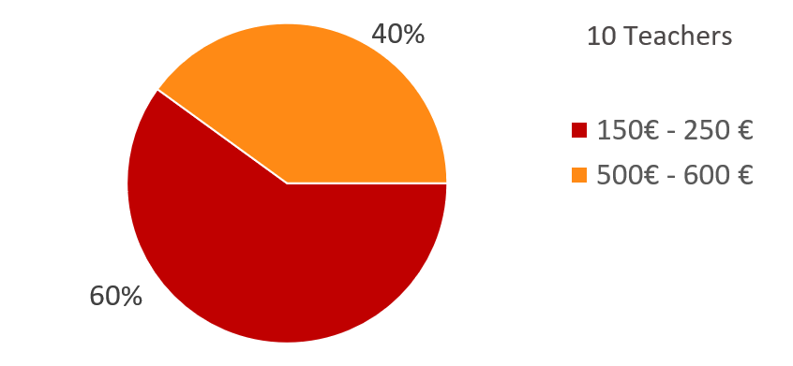
Results: Figures
Licenses’ price (Teachers)
44
Notes:
Finally, we asked the schools about the prices of the annual licenses, and most of them would pay between 150 and 250 euros, which is the price of our smallest annual license with 60 users and 20 free exercises, or between 500 and 600 euros, which is the one of our medium annual license with 200 users and 50 free exercises. Also, we have available in case that our users need it a annual license with 500 users, 75 free exercises and 700 euros.

Slide 45
Status
Notes:
Finally, we’ll see the current situation of the project.

Slide 46
Current Costs & Time
50%
936 h
0%
100%
€18K
€29K
1120 h
Current: €63%, 83% h
Budgeted: €57%, 57% h
46
Notes:
Currently we’ve spent a total amount of 936 hours and 18k euros, which is a 83 and a 63 percent from the total, and different from the 57 expected this week.

Slide 47



Costs’ Explanation
Direct Costs: €13,5k
Indirect Costs: €4,6k
47
Notes:
That money investment is divided in direct and indirect costs, having the amount shown in the slide for each one.

Slide 48
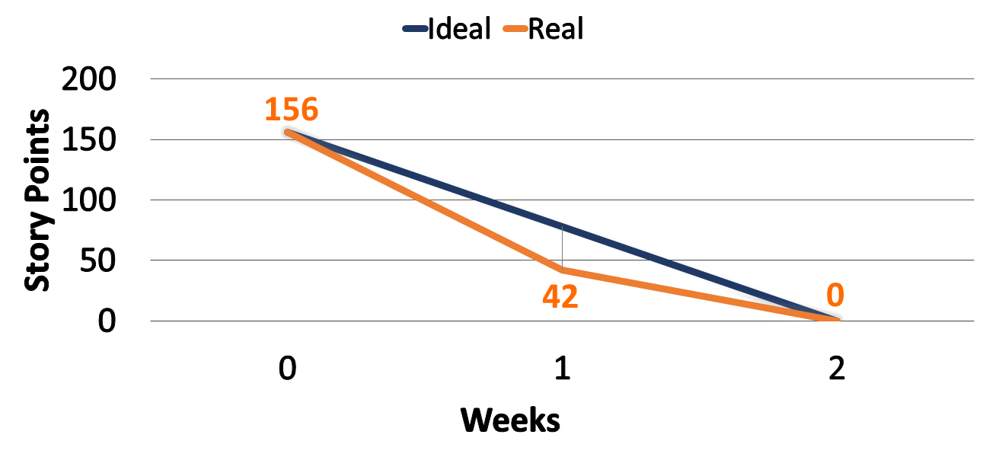
Current Sprint’s SP
48
Notes:
These hours and money investments are visible in these burndown graphics. The first one shows us the amount of Story Points done in this sprint, comparing it to the ideal development of it. As we see, we’ve completed every story point set for this sprint.

Slide 49
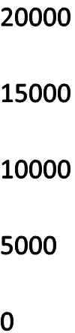
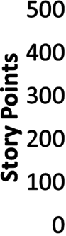
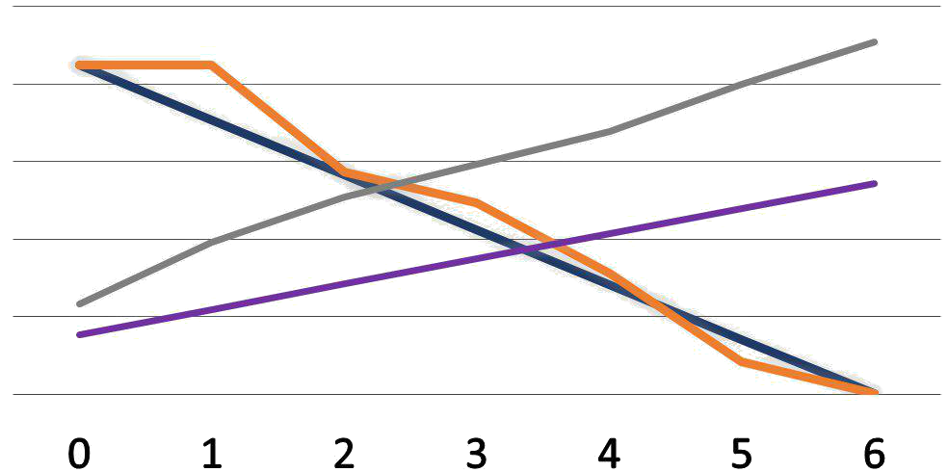

Current Project’s Situation
49
Notes:
The second graphic shows us the progress made during the full development of the project and the ideal development of it. As we see, we’ve completed every story point of our project by now, but in terms of money we’re above the ideal progress, due to our hours’ investment.

Slide 50
Current Project’s Usage
Current usage: 53%
Evolution: +4 users/week
50
Notes:
Seeing those figures makes us think about the viability of our project. In order to measure it, we decided to study the current usage of our platform. We saw that the current number of users is the 53% of the ones inverviewed, with an increase of 4 users per week.

Slide 51
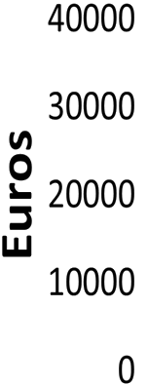
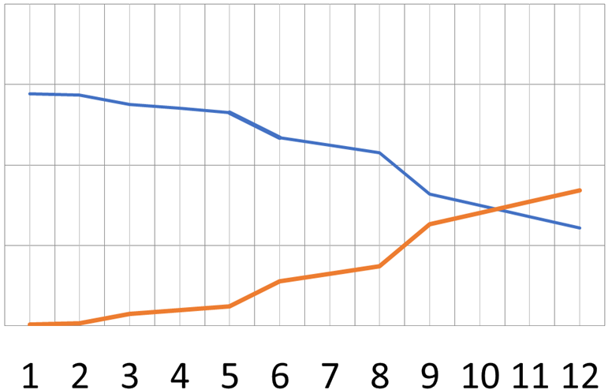
Breaking Point
51
Notes:
Having that in mind, we can see that our breaking point is located on the 10th month after the release of the product, increasing the number of users in the amount we’ve seen before, and having an average purchase of exercises of 10 per month.

Slide 52

Conclusions
MVP FINISHED
52
Notes:
So, as a conclusion, we can say that we have finished the MVP of our project, and now a new phase begins, more focused in marketing and getting more users for our platform.
This situation is all thanks to our team’s effort in the development phase, and that makes us very positive in our project, becasue if we did this good during development, we can expect a good performance during the next phases of the project, too.

Slide 53

THANKS!
You can find me at
alvdomnun@alum.us.es
53
Notes:
And that’s the end of our presentation! Thank you for watching, and if you have any doubt you can contact me at alvdomnun@alum.us.es.

